Slide 1
Title: Ration Management System
Subtitle:
Efficient Management of Ration Distribution

Slide 2
Presented by
SHABBIR AHMAD(240028)
IMTIAZ ALI (240026)
JAVED ALI (240484)
SAHRJEEL (240016)
Naila Saleem (240039)

Slide 3
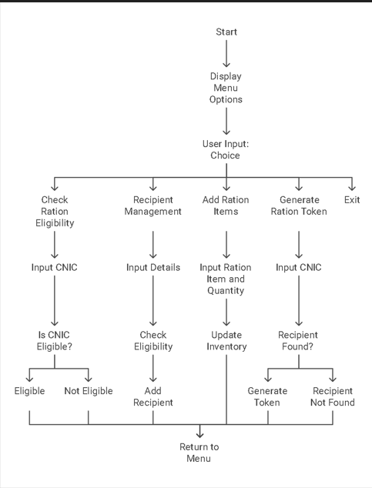
Flow chart

Slide 4
Agenda
Key Discussion Points:
Introduction to the Ration Management System
Purpose of the Project
Key Features of the System
How the System Works
Eligibility Criteria
Ration Token Generation Process

Slide 5
Agenda
7. Benefits and Use Cases
8. Conclusion and Future Enhancements
9. Q&A Session
Presentation Objectives:
To explain the functionality and benefits of the Ration Management System.
To demonstrate how the system improves the distribution of ration supplies.
To discuss the impact of the system on aid distribution in Pakistan.

Slide 6
Introduction
What is the Ration Management System?
A system designed to manage the distribution of ration supplies to eligible recipients.
Ensures fair and organized distribution.

Slide 7
Purpose of the Project
Main Objectives:
To streamline the process of ration distribution in Pakistan.
To ensure efficient management of ration inventory and recipients across various regions.
To support the government's efforts in providing aid to eligible individuals in underprivileged and disaster-affected areas.
To enhance transparency and accountability in the ration distribution process.

Slide 8
Key Features
Recipient Management:
Add new recipients with their details.
View all recipient information.
Ration Inventory Management:
Add and manage ration items in inventory.
Eligibility Check:
Check if a recipient is eligible based on their CNIC.
Ration Token Generation:
Generate tokens for eligible recipients

Slide 9
How the System Works
Step 1: Add Recipient Details
Input CNIC, Name, and Address.
System checks eligibility automatically.
Step 2: Manage Ration Inventory
Add ration items like sugar, flour, oil, and milk.
Step 3: Generate Ration Token
For eligible recipients, generate a token.
Allocate ration items from inventory.

Slide 10
Eligibility Check
Criteria:
Based on the first 5 digits of the CNIC.
Matches CNIC against eligible districts.
Why This Matters:
Ensures that only residents of specific areas receive aid.

Slide 11
Ration Token Generation
Process:
Enter recipient's CNIC.
System records the date and allocates available ration items.
Output:
List of ration items provided to the recipient.

Slide 12
Benefits of the System
Efficiency:
Quick and organized distribution process.
Accountability:
Transparent record of recipients and ration distribution.
Scalability:
Can be expanded to include more areas and ration items.

Slide 13
User Interaction Flow
Menu Options:
Check Ration Eligibility.
Manage Recipients.
Add Ration Items.
Generate Ration Tokens.
User Inputs:
Simple prompts for CNIC, names, and item quantities.

Slide 14
Example Use Case
Scenario:
A recipient from Sukkur wants to receive rations.
Steps:
Add recipient details.
Check eligibility (district code 41201).
Add ration items to inventory.
Generate ration token and distribute items

Slide 15
Conclusion
Summary:
The Ration Management System simplifies and organizes the distribution process.
Ensures fairness and efficiency in providing aid.
Future Enhancements:
Adding more features like detailed reporting and mobile app integration.

Slide 16
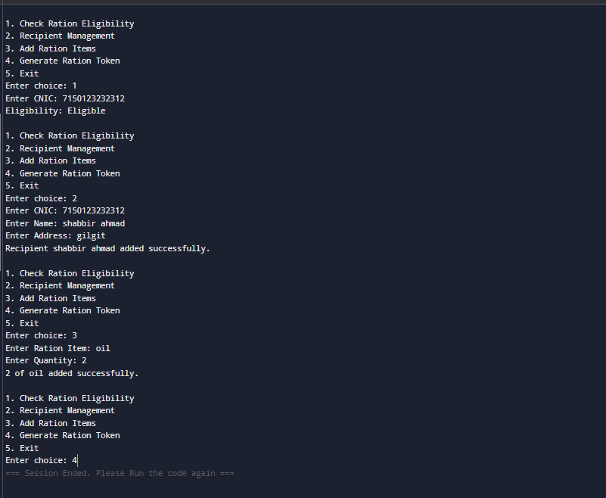
Finally Output Of Project

